Slide 1

what is 'it'?
Now consider these sentences.
We adopted a new pet this weekend.
I ordered something I really wanted from the store.
I bought a ticket and won a prize.
If we said any of these things to a friend or coworker, it might be frustrating for them.
We haven't given them enough information in any of these cases.
In other words, they can't paint a picture in their head, because they lack details.
New pet, something ordered, and a ticket, are too general when talking about one item.
COMPLETE JAVA MASTERCLASS
Abstract Classes Part 1

Slide 2
what is 'it'?
On the other hand, when we talk about groups of things, we don't usually need too many specifics.
Consider these sentences.
I need to get home to feed the animals.
I'm waiting for my box of stuff from an online store to be delivered.
So here, 'animals', and 'stuff', are probably enough information, to fully describe the situation.
COMPLETE JAVA MASTERCLASS
Abstract Classes Part 1

Slide 3
The abstract class
The abstract class is declared with the abstract modifier.
Here we are declaring an abstract class called Animal.
An abstract class is a class that's incomplete.
You can't create an instance of an abstract class.
An abstract class can still have a constructor, which will be called by its subclasses, during their construction.
COMPLETE JAVA MASTERCLASS
Abstract Classes Part 1

Slide 4
The abstract class
An abstract class's purpose, is to define the behavior it's subclasses are required to have, so it always participates in inheritance.
For the examples on this slide, assume that Animal is an abstract class.
Classes extend abstract classes, and can be concrete.
Here, Dog extends Animal, Animal is abstract, but Dog is concrete.
COMPLETE JAVA MASTERCLASS
Abstract Classes Part 1

Slide 5
The abstract class
A class that extends an abstract class, can also be abstract itself, as I show with this next example.
Mammal is declared abstract and it extends Animal, which is also abstract.
And finally an abstract class can extend a concrete class.
Here we have BestOfBreed, an abstract class, extending Dog, which is concrete.
COMPLETE JAVA MASTERCLASS
Abstract Classes Part 1

Slide 6
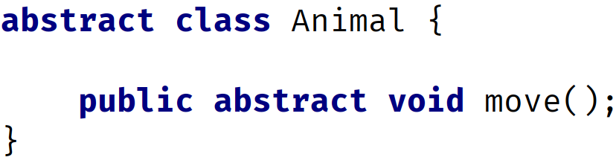
What's an abstract method?
An abstract method is declared with the modifier abstract.
You can see on this slide, that we're declaring an abstract method called move, with a void return type.
It simply ends with a semi-colon.
It doesn't have a body, not even curly braces.
Abstract methods can only be declared on an abstract class or interface.
COMPLETE JAVA MASTERCLASS
Abstract Classes Part 1

Slide 7
What good is an abstract method, if it doesn't have any code in it?
An abstract method tells the outside world, that all Animals will move, in the example we show here.
Any code that uses a subtype of Animal, knows it can call the move method, and the subtype will implement this method with this signature.
This is also true for a concrete class, and a concrete method that's overridden.
You might be asking, what's the difference, and when would you use an abstract class.
COMPLETE JAVA MASTERCLASS
Abstract Classes Part 1

Slide 8
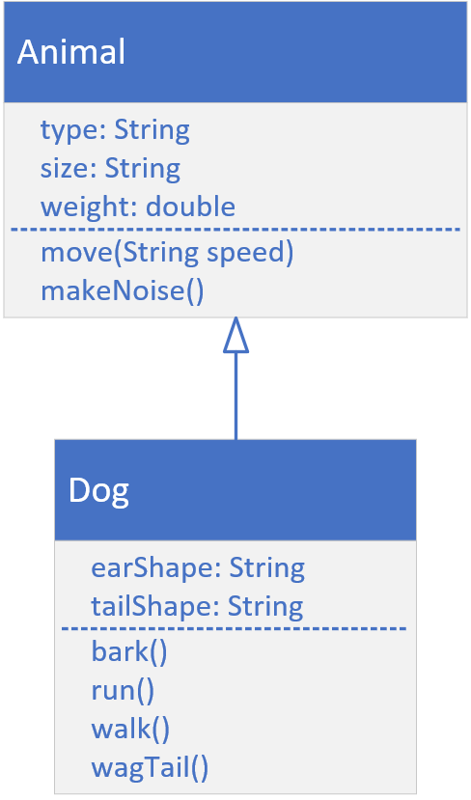
Animal and Dog Class Diagram from our Inheritance example
In the videos on inheritance, we created a very basic Animal class, and then we extended it to create a Dog.
Here, I show you the class diagram from that lecture again.
 | In that example, Animal was a concrete class, so the move and makeNoise methods had code in their method bodies. Subclasses have choices when they extend a concrete class with concrete methods. They can inherit the same behavior from their parent. This means they don't have to even declare the methods in their class bodies. They can override the behavior from their parent. This means they have a method with the same signature, but with their own code in there, ignoring the parent's code altogether. They can also override the behavior but leverage the parent's method code, by calling the parent's method, using super in their overridden code.
COMPLETE JAVA MASTERCLASS
Abstract Classes Part 1

Slide 9
Animal and Dog Class Diagram, What if Animal were abstract?
But what happens if Animal is declared as abstract, and the move and makeNoise methods are also abstract?
 | If Animal is abstract and it's methods are abstract, subclasses no longer have the options we just talked about. There is no concrete method for a subclass to inherit code from. Instead, the subclass must provide a concrete method for any abstract method declared on its parent. The subclass won't compile if it doesn't implement the abstract methods.
COMPLETE JAVA MASTERCLASS
Abstract Classes Part 1

